Slide 1
Chapter Eleven
Pricing Strategies

Slide 2
Pricing Strategies
New-Product Pricing Strategies
Product Mix Pricing Strategies
Price Adjustment Strategies
Price Changes

Slide 3
New-Product Pricing Strategies
Market-skimming pricing
Market-penetration pricing
Market-skimming pricing is a strategy with high initial prices to “skim” revenue layers from the market
    Product quality and image must support the price
    Buyers must want the product at the price
    Costs of producing the product in small volume should not cancel the advantage of higher prices
    Competitors should not be able to enter the market easily

Slide 4
New-Product Pricing Strategies
Market-penetration pricing sets a low initial price in order to penetrate the market quickly and deeply to attract a huge number of buyers quickly to gain market share
    Price sensitive market
    Inverse relationship of production and distribution cost to sales growth
    Low prices must keep competition out of the market

Slide 5
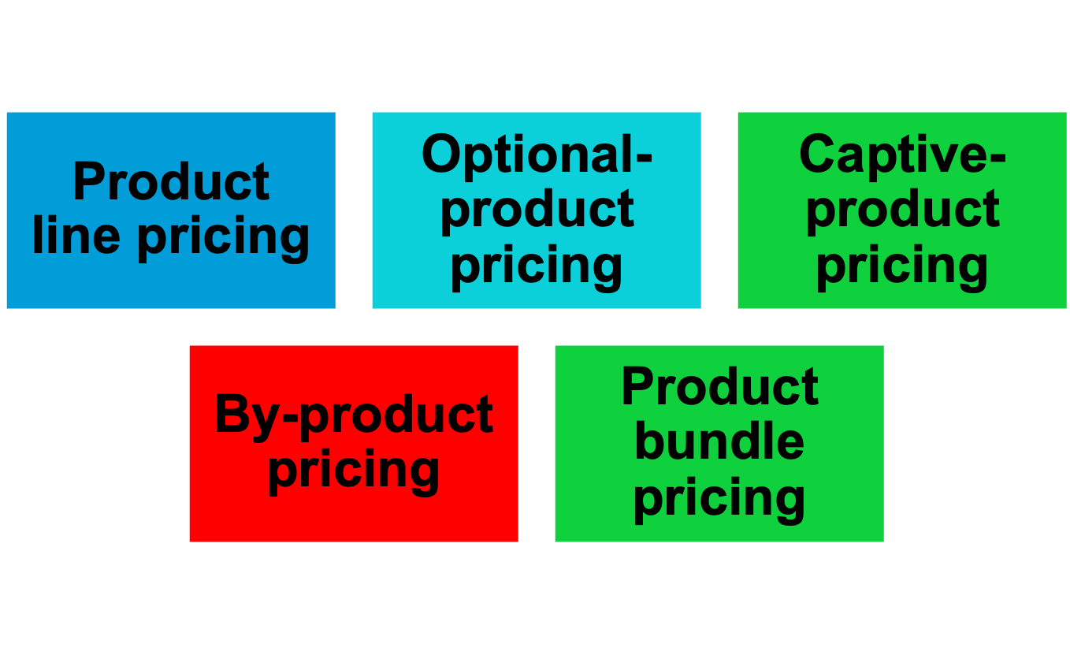
Product Mix Pricing Strategies

Slide 6
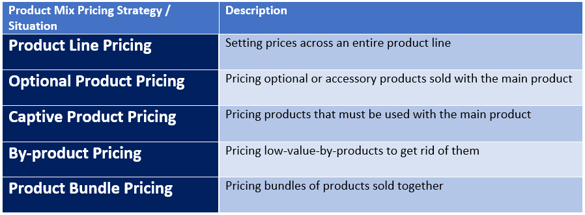

Slide 7
Product Mix Pricing Strategies
Product line pricing takes into account the cost differences between products in the line, customer evaluation of their features, and competitors’ prices
Optional product pricing takes into account optional or accessory products along with the main product

Slide 8
Product Mix Pricing Strategies
Captive-product pricing involves products that must be used along with the main product
Two-part pricing involves breaking the price into in case of services:
  Fixed fee
  Variable usage fee

Slide 9
Price Mix Pricing Strategies
By-product pricing refers to products with little or no value produced as a result of the main product. Producers will seek little or no profit other than the cost to cover storage and delivery.

Slide 10
Price Mix Pricing Strategies
Product bundle pricing combines several products at a reduced price

Slide 11
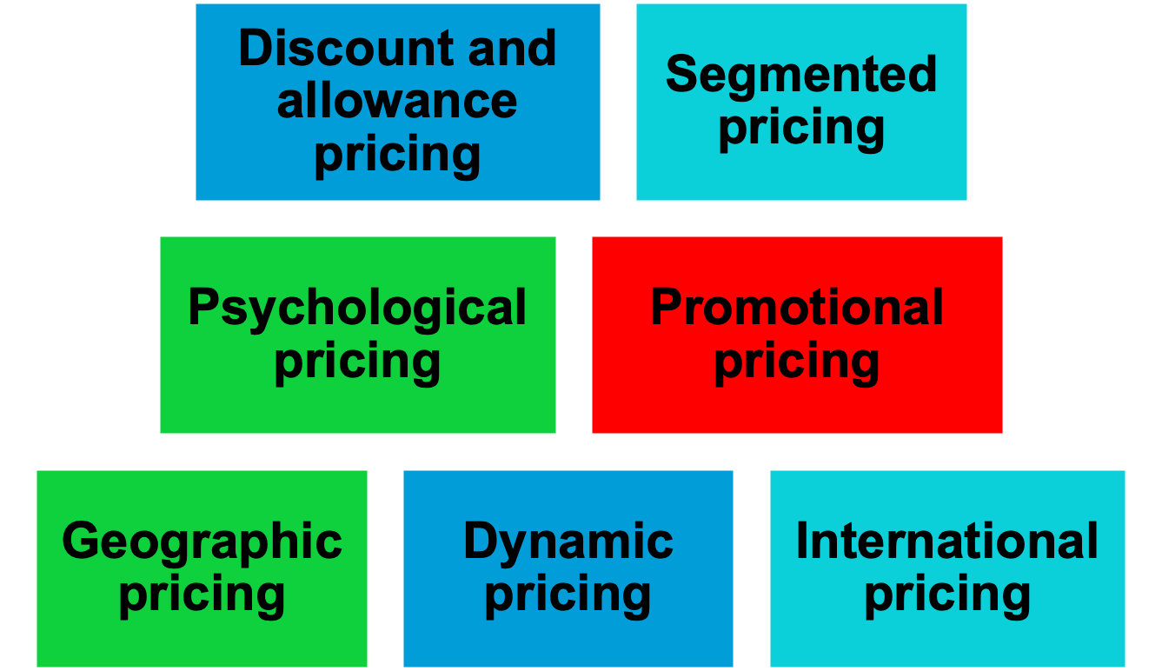
Price-Adjustment Strategies

Slide 12
Price-Adjustment Strategies
Discount and allowance pricing reduces prices to reward customer responses such as paying early or promoting the product
Discounts such as cash discount, quantity discount, functional discount, seasonal discount,
Allowances such as trade in allowance, promotional allowance.

Slide 13
Price-Adjustment Strategies
Segmented pricing is used when a company sells a product at two or more prices even though the difference is not based on cost
Customer segment pricing (price for senior people, adults and kids)
Product form pricing (Different version of the product price differently)
Location Pricing (window seat in plane, Student fee)
Time pricing (change in price at different timings)

Slide 14
Price-Adjustment Strategies
To be effective:
Market must be segmentable
Segments must show different degrees of demand
Watching the market cannot exceed the extra revenue obtained from the price difference
Must be legal

Slide 15
Price-Adjustment Strategies
Psychological pricing occurs when sellers consider the psychology of prices and not simply the economics
Reference prices are prices that buyers carry in their minds and refer to when looking at a given product

Slide 16
Price-Adjustment Strategies
Promotional pricing is when prices are temporarily priced below list price or cost to increase demand
Loss leaders
Special event pricing
Cash rebates
Low-interest financing
Longer warrantees
Free maintenance

Slide 17
Price-Adjustment Strategies
Risks of promotional pricing
Used too frequently, and copies by competitors can create “deal-prone” customers who will wait for promotions and avoid buying at regular price
Creates price wars

Slide 18
Price-Adjustment Strategies
Geographical pricing is used for customers in different parts of the country or the world
FOB pricing
Uniformed-delivery pricing
Zone pricing
Basing-point pricing
Freight-absorption pricing

Slide 19
Price-Adjustment Strategies
FOB (free on board) pricing means that the goods are delivered to the carrier and the title and responsibility passes to the customer
Uniformed delivery pricing means the company charges the same price plus freight to all customers, regardless of location

Slide 20
Price-Adjustment Strategies
Zone pricing means that the company sets up two or more zones where customers within a given zone pay a single total price
Basing point pricing means that a seller selects a given city as a “basing point” and charges all customers the freight cost associated from that city to the customer location, regardless of the city from which the goods are actually shipped

Slide 21
Price-Adjustment Strategies
Freight absorption pricing means the seller absorbs all or part of the actual freight charge as an incentive to attract business in competitive markets

Slide 22
Price-Adjustment Strategies
Dynamic pricing is when prices are adjusted continually to meet the characteristics and needs of the individual customer and situations

Slide 23
Price-Adjustment Strategies
International pricing is when prices are set in a specific country based on country-specific factors
Economic conditions
Competitive conditions
Laws and regulations
Infrastructure
Company marketing objective

Slide 24
Price Changes
Initiating price changes
    Price cuts
        Excess capacity
        Increased market share
    Price increases
        Cost inflation
        Increased demand
        Lack of supply

Slide 25
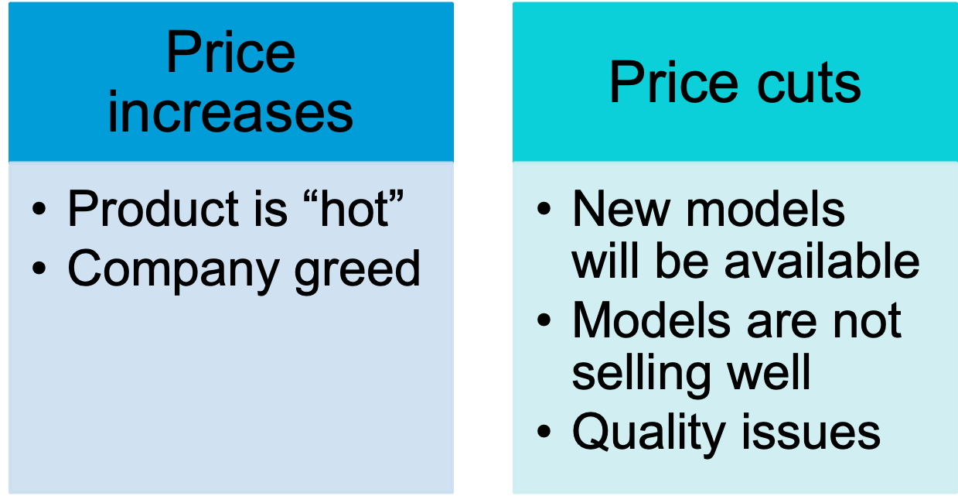
Buyer Reactions to Pricing Changes

Slide 26
Responding to Price Changes
Questions
  Why did the competitor change the price?
  Is the price cut permanent or temporary?
  What is the effect on market share and profits?
  Will competitors respond?

Slide 27
Responding to Price Changes
Solutions
  Reduce price to match competition
  Maintain price but raise the perceived value through communications
  Improve quality and increase price
  Launch a lower-price “fighting” brand

